Slide 1

DEPARTMENT OF MATHEMATICS
S.G.G.S.J GOVT. COLLEGE
PAONTA SAHIB

Slide 2
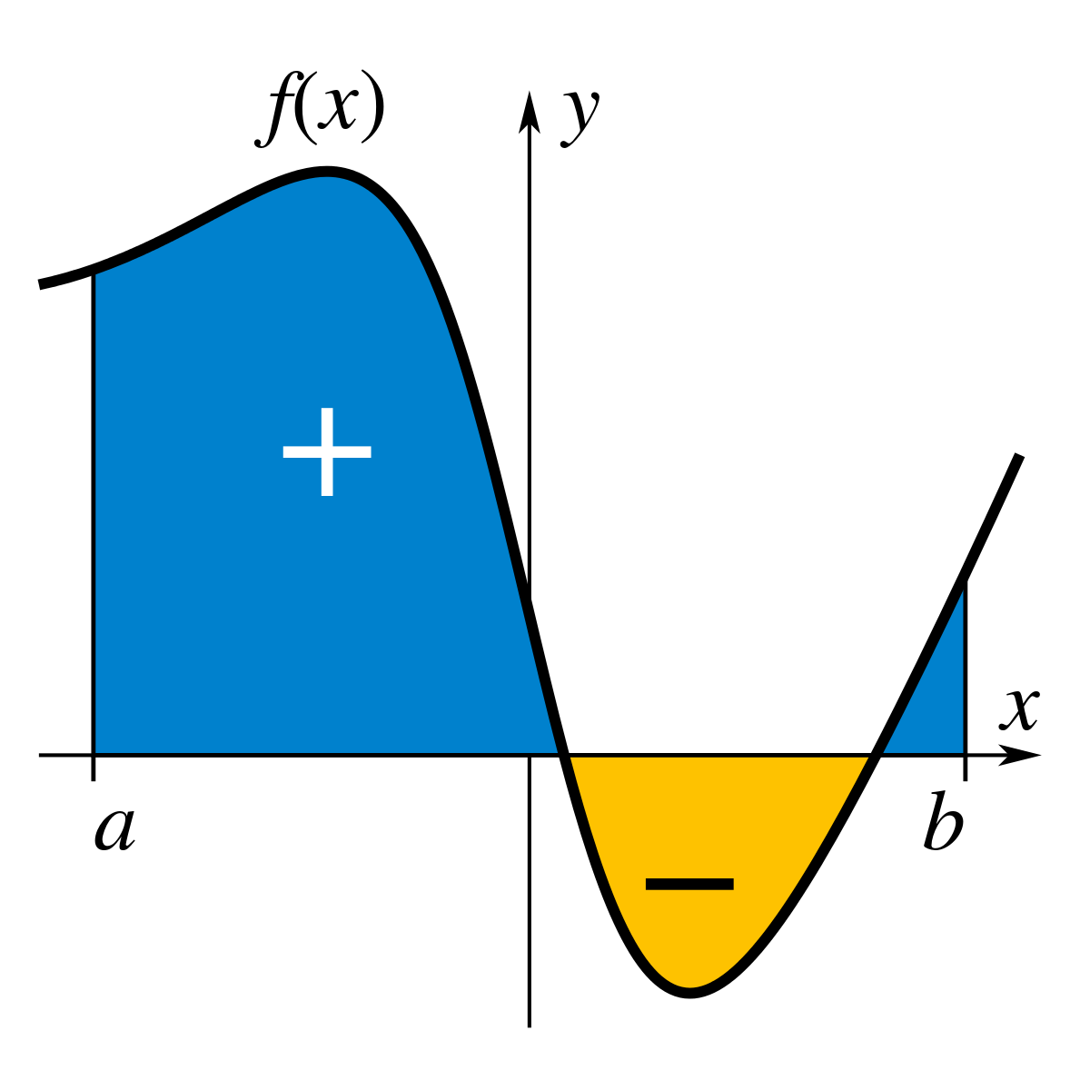
COURCE NAME :-INTEGRAL CALCULUS
COURCE CODE :- MATH309TH

Slide 3
CONTENT
1. INTRODUCTION
2. CURVE
3. LENGTH OF CURVE
4. RECTIFIABLE CURVE
5. RECTIFICATION
6. ARC FORMULA FOR CARTESIAN EQUATION
7. Length of an arc of a plane curve with parametric equation

Slide 4
Introduction :- Determining the length of a curve on a plane or in space is known as rectification of the curve. Rectification of curves is an important problem in physics, computer graphics and engineering. Towards the middle of the seventeenth century Hendrik van Heuraet and Pierre de Fermat, the two eminent mathematicians invented independently the formula for rectification of curves on a plane.

Slide 5
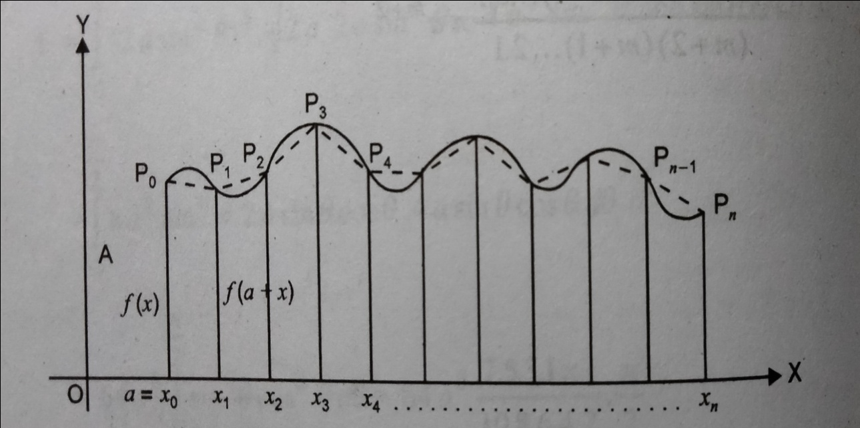
2. Curve:- Let f be a continous function on [a,b] . Then the graph of f on [a,b] i.e., {(x,f(x) : a≤x≤b} is called a curve .
3.Length of curve :- Let AB the curve defined by continuous function y= f(x) on [a,b]

Slide 6
Let P=(a = x1​,x2​,x3​,... Xn-1,xn​ =b ) be a partition of [a, b] into n equal parts each of length h,
where h= (b-a) /n
Let Pi (xi, f(xi)) be a point on the curve AB. Then Po =A, Pn=B. Now Po, P1, P2 ,P3 are consecutive points on the curve. Join each pair Pi-1 , P of consecutive points by line segments and we get broken lines PoP₁ , P1P₂ , Pn-1Pn .When n is very large the line segment Pi-1 Pi will be the approximate part of the curve which corresponds to the sub-interval [xi-1, x].
Therefore , as n→ ∞ the broken line approaches the curve
Length of the curve L= lim ∑|Pi−1Pi|
n
n→∞
i=1

Slide 7
4. Rectifiable curve :- A continous curve which has length is called rectifiable
5. Rectification :- The process of finding the length of an arc of a curve between two given points is called rectification
6. Arc Formula for Cartesian Equation
L=∫ √1+(dy/dx)^2 dx
b
a

Slide 8
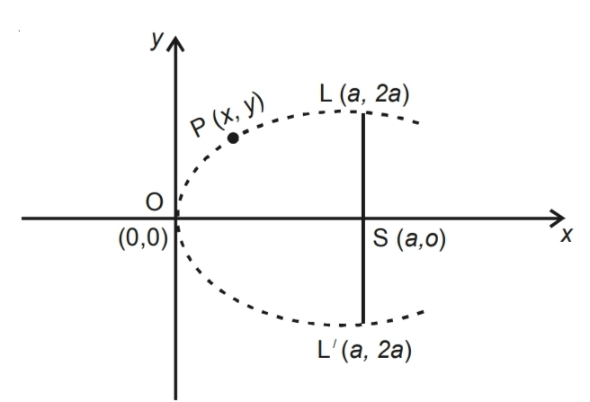
Question : 1- Find the length of the arc of the parabola y^2 = 4ax extending
from the vertex to an extremity of the latus rectum.
Solution: For the parabola y^2 = 4ax the coordinates of the vertex O are
(0,0) and the coordinates of one extremity L of the latus rectum LSL` are
(a, 2a). Now we are to find the length of the arc from O to L.
Now, y^2 = 4ax
Differentiating w.r.t. x, we get
2y dy/dx = 4a

Slide 9
Therefore , dy/dx = 2a/y
or dx/dx = y/2a ……………..(1)
If s denotes the length of the parabola measured of the vertex O
to any point P(x,y) towards the point L, then S increases as y increases.
Therefore dy/ds is positive. So we can write
Now (dy/dx)^2 = 1 +(dx/dy)^2
1+ (y/2a)^2
=(4a^2 +y^2)/4a^2
Therefor ds/dx=√(4a^2 +y^2)/4a^2
ds=1/2a√4a^2+y^2 dy
Y=2a
1/2 √4a^2 +y^2 dy
S= ∫
Y = 0

Slide 10
= ½ [y/2 √4a^2 +y^2 + 4a^2 / 2 log 2 {y+ √4a^2 + y^2 }]
2a
0
= 1 /2a[2a / 2 √4a^2 +4a^2 + 2a^2 log (2a +√4a^2 +4a^2) -2a^2 log 2a
= 1 /2a [a.2a √2 +2a^2 log (2a + 2a √2) -2a^2 log 2a
= a[√2 + log ( 1 +√2)]
7. Length of an arc of a plane curve with parametric equation
b
L = ∫√(dx/dt)^2 + (dy/dt)^2 dt
a

Slide 11
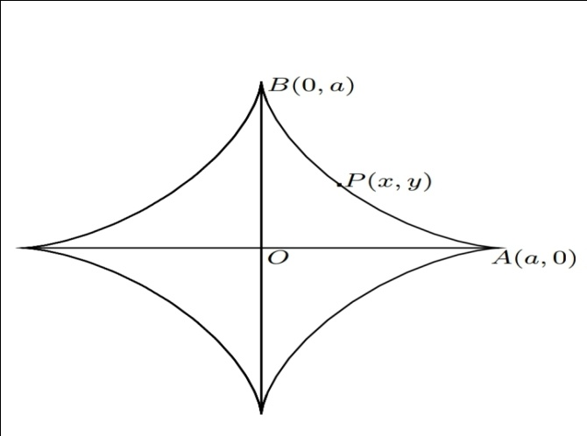
Question :-Find the entire length of the astroid x^2/3 +y^2/3 =a^2/3
Solution :- Here X^2/3 +y ^2/3 = a^2/3 …………. (!)
diff. w.r.t. ‘ x’ we get
2/3 x^(-1/3) + 2/3 y^(-1/3) = 0
dy/dx = - ( y/x)^1/3
(dy/dx)^2 = y^(2/3) / x^(2/3)
1+ (dy/dx) = 1+ y^(2/3) / x^(2/3)
using eqn (1) we get

Slide 12
1+ (dy/dx) = 1+ a^2/3 /x^2/3 = a^2/3 x^-2/3
The entire length of astroid is
4 arc AB = 4 ∫√ 1+ ( dy/dx)^2 dx
= 4 ∫ a^2/3 x^-2/3 dx
= 4 a^1/3 [ x^(2/3) / 2/3 ]
= 4a^1/2 (a^2/3 / 2/3 = 6a
0
a
0
a

